Slide 1
Melanoma Deep Learning Challenge
Edwing Ulin
Yusuf

Slide 2
Deep Network Architecture
Transfer Learning with:
Efficient Net B0
Inception V3
Input is resize to:
299*299 pixels
Normalize image:
mean=[0.485, 0.456, 0.406]
std=[0.229, 0.224, 0.225]

Slide 3
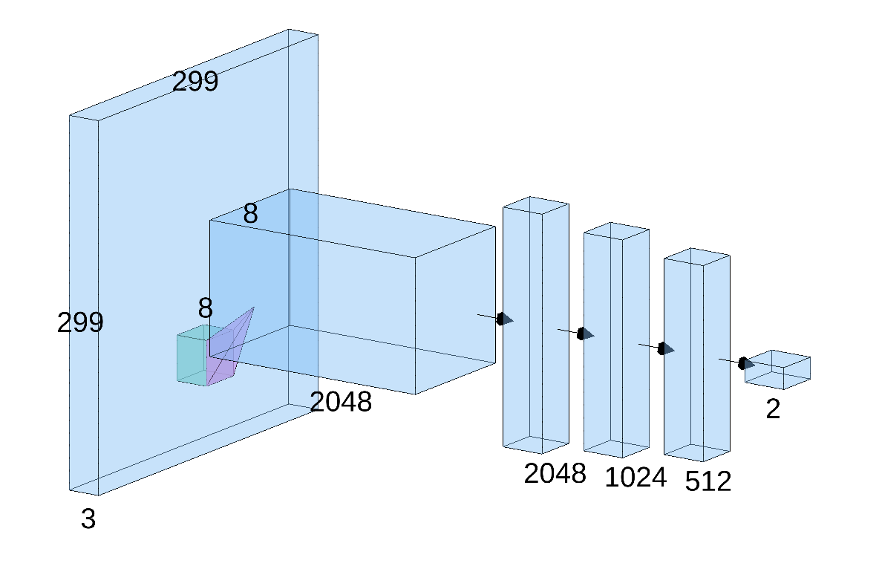
Classification Layer
3 convolution Layers
2 Relu Activations Layers
2 Drop Rate Layers
Some implementation have a Attention Layer
We choose the first 1024 layers
First convolution past to 512 features
2 or 3 class are selected

Slide 4
Fitting
Use of ADAM optimizer
Create a CyclicLR Scheduler to calculate the steps of the learning rate depending on the epochs.
Use this weights: Inception_V3_Weights,EfficientNet_B0_Weights
Criterion: CrossEntropyLoss
Training loop save the best classifier with the lowest loss.

Slide 5
Binary test
We want to see the effect of the drop rate on the accuracy:
Drop Rate: 0.5, 0.7, 0.3 and without
We try to use some simple preprocessing:
Contrast Limited Adaptive Histogram Equalization (CLAHE)
along with min-max normalization
A simple Attention Mechanism was apply. (Random weights)
Masks were tried, but with a simple classification using masks as input give us a poorly ACC around 57%. We determine that the quality of a masks is not the best so we drop this tests.

Slide 6
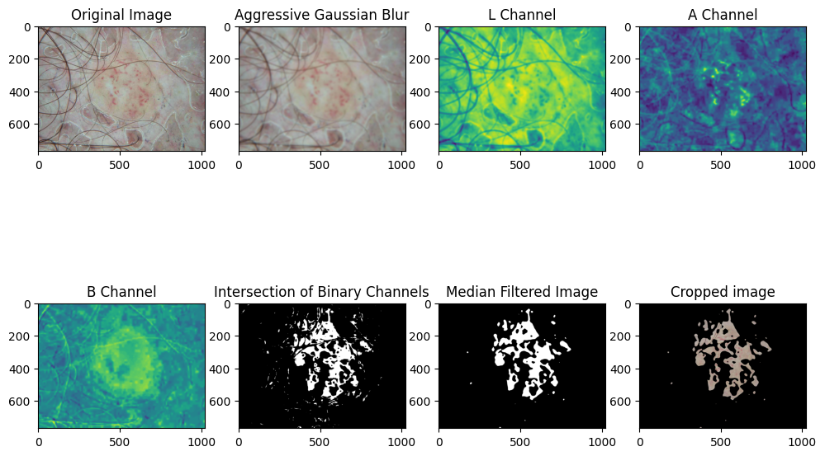
Mask process

Slide 7
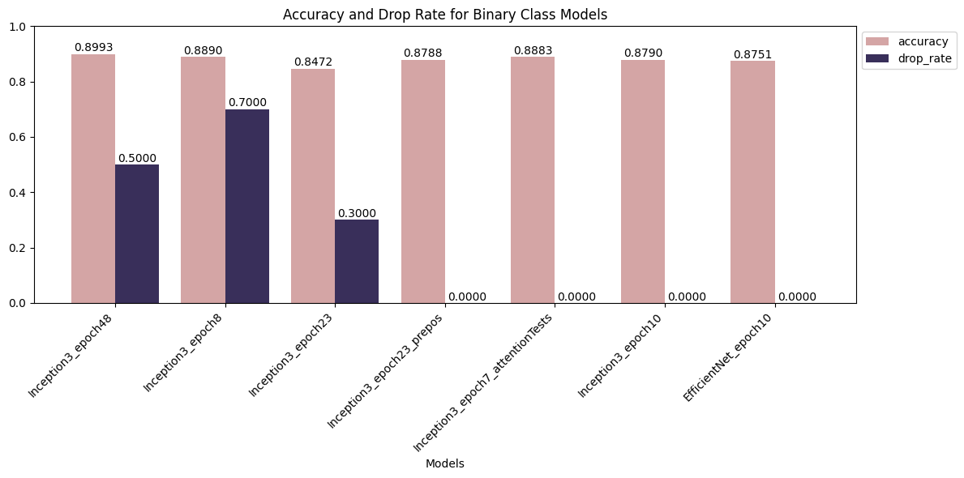

Slide 8
Multi class Classifier
Based on the binary class, we implemented the next tools to play against the unbalanced dataset:
Use of class weights.
Use of WeightedRandomSampler.
to give us a sample that is not unbalanced per epoch.
More epochs.

Slide 9
Binary SCC approach
We created 6 new dataset that match the size of the scc, the others folder consists on a random sample of the bcc and mel distribution.
We train this new dataset using 10 epochs and the 2 extraction models.
With the new 12 models we obtain by maximum voting a new classifier.
This new classifier has a 92% ACC.
With this one we used to get a better classification of the SCC class.

Slide 10
